Slide 1

TO-DO-LIST APP
CS 499 – Senior project

Slide 2

PROJECT requirements
Solves a problem/makes life easier/improves something
Interesting and exciting
Involves research, discovery, and implementation of new IT/Software concepts

Slide 3
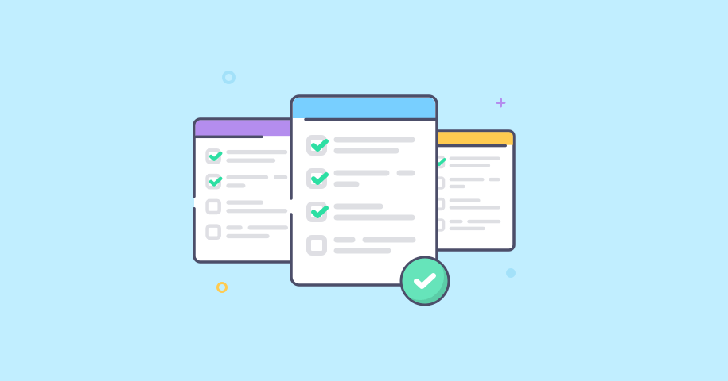
Solves a problem / makes life easier / improves something
To-do lists help users be more productive by preventing them from forgetting things, helping them prioritize tasks, manage duties successfully, make the best use of their time, and improving workflow.

Slide 4

Interesting and exciting
An app is a self-contained software package that allows users to perform specific tasks on a mobile or desktop device.

Slide 5

Involves research, discovery, and implementation of new IT / Software concepts
Users want a strong and complex development environment to create apps. App development software provides an environment that divides projects into workable components using organized code modules so that users may independently design, test, and debug those components.

Slide 6

TO-DO-LIST app
Introduction: To-Do List project is an application specially built to keep track of errands or tasks that need to be done. This application will be like a task keeper where the user would be able to enter the tasks that they need to do. Once they are done with their tasks, they can also remove them from the list.
Purpose: Using a to-do list enables users to mark off the task's users have completed. At the end of the day, when users look at the list, it will give users a sense of accomplishment and satisfaction. It might also have the effect of waking users up if nothing has been marked completed..
Scope: Organization of a proper work with an accurate planning of every task with its short description.
Technologies Used: Android Studio and Java

Slide 7

TO-DO-LIST app REQUIREMENTS / DEMO
The system shall display all the products that can be configured.
The system will accept text from the cell phone, computer or autocorrect keyboard.
The system shall be able to create new tasks.
The system shall be able to check a task.
The system shall be able to uncheck a task.
The system shall be able to delete a task.
The system shall be able to edit task.

Slide 8
SCRUM
Scrum is a framework for project management that emphasizes teamwork, accountability and iterative progress toward a well-defined goal. The framework begins with a simple premise: Start with what can be seen or known. After that, track the progress and tweak, as necessary.

Slide 9
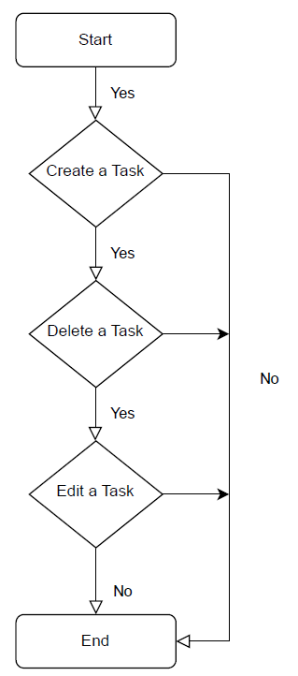
FUNCIONALITY DIAGRAM

Slide 10
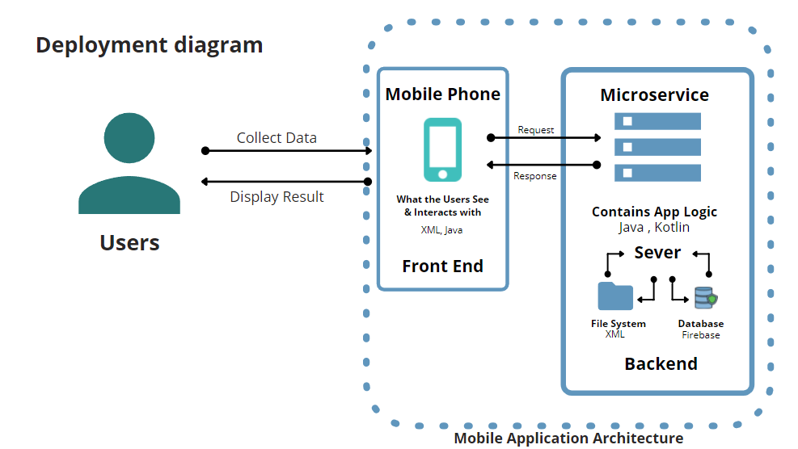
Conex ion diagram

Slide 11
Code

Slide 12
Challenges / issues and what did I do about them.

Slide 13
Things I have learned, project highlights, and what would I do differently

Slide 14
RESOURCES
https://developer.android.com/guide/platform
https://www.w3schools.com/
https://www.youtube.com/@PenguinCoders

Slide 15

Thank you
PENELOPE SANCHEZ

